Slide 1
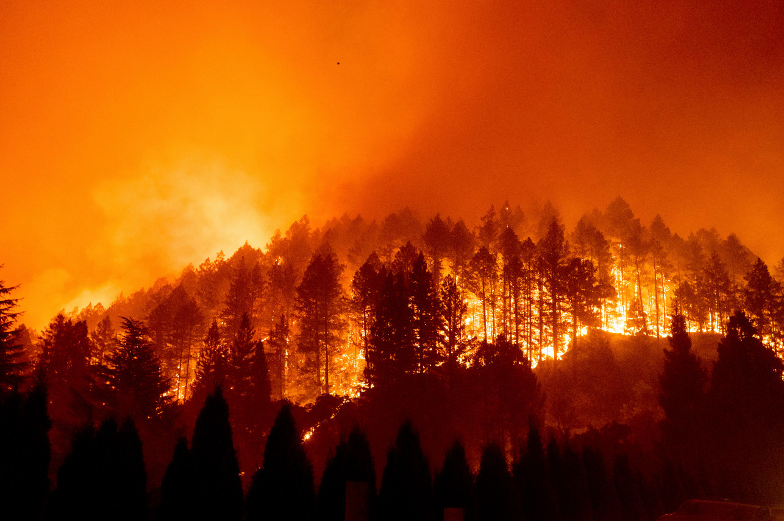
CALIFORNIA WILDFIRE CAUSE AND EFFECT ANALYSIS
JASON LEI
JOSH GALLAGHER
THADDEUS GRAY
WAN XIA (SUSAN)
YU-HAN CHEN (AMY)

Slide 2
Causes of Wildfires: Weather
Questions
Is there a difference between average weather on any day for a location, and the weather in the location of a fire?
Are there weather trends in the time prior to the fire being contained?

Slide 3
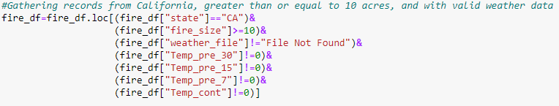
Weather Data Cleaning
Limited to California
Removed fires less than 10 Acres
Removed records that did not have weather files
Removed records where temperature equaled exactly 0

Slide 4
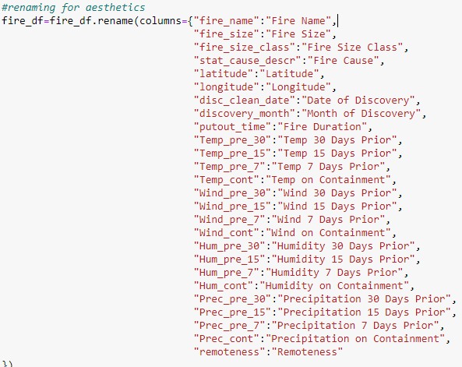
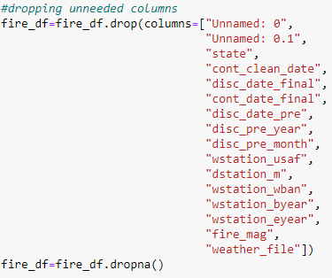
Weather Data Cleaning
Removed columns that would not be used
Renamed columns so Dataframe would be more aesthetically pleasing

Slide 5
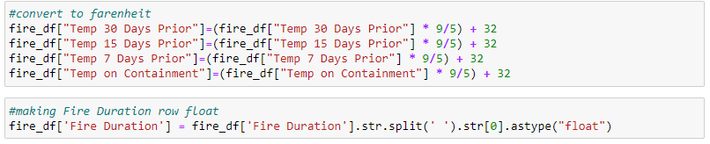
Weather Data Cleaning
Converted to Fahrenheit
Fire Duration column needed strings removed and to be turned into float for later calculations

Slide 6
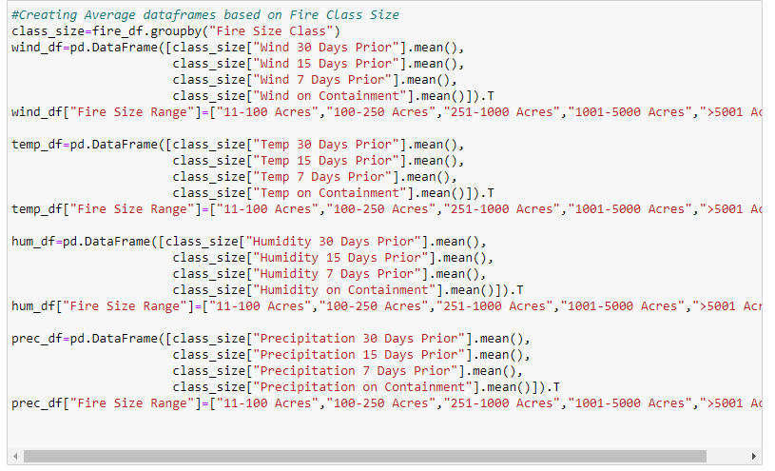
Weather Data Cleaning
Grouped data by the size of the fire
Created separate dataframes for wind, temperature, humidity, and precipitation
Took averages for time periods prior to fires’ containment

Slide 7
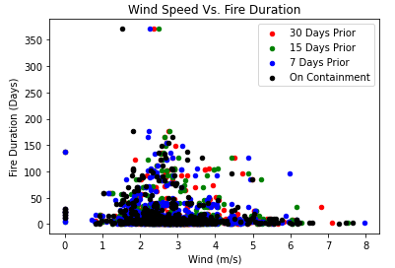
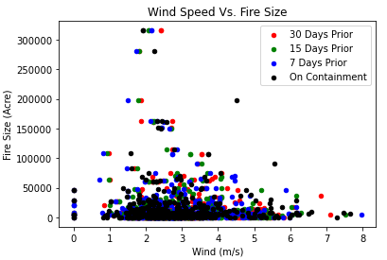
Wind
Mostly grouped in 1 to 5 m/s
Duration drops significantly above 5 m/s
Lots of datapoints at 0 m/s, however none in between until almost 1 m/s. Could be error in measurements or data.

Slide 8
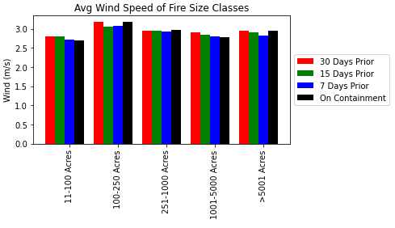
Wind
There appears to be a consistent pattern of wind speed averages dropping until date of containment

Slide 9
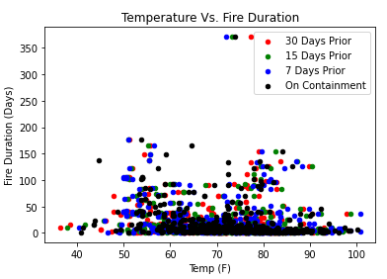
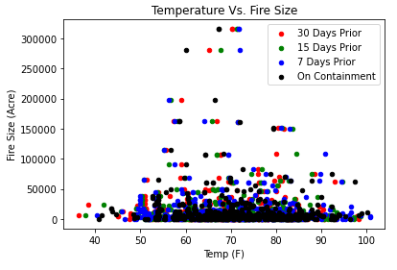
Temperature
Not much can be inferred from these graphs

Slide 10
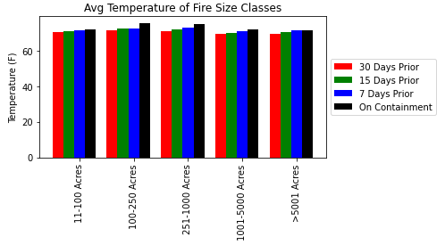
Temperature
The temperature rises up until date of containment
Temperature averages are consistent across all fire sizes

Slide 11
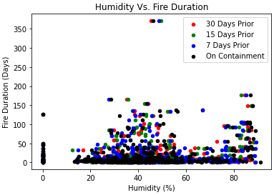
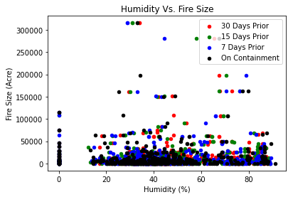
Humidity
Between 60 and 75% humidity, there is a decrease in the duration of the fires
Data clumped at 0% humidity, but none until about 10%

Slide 12
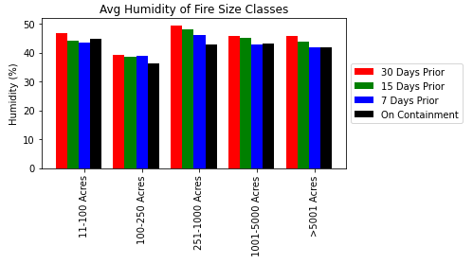
Humidity
Humidity decreases up until the date of containment
Fires 100-250 acres tend to have lower humidity

Slide 13
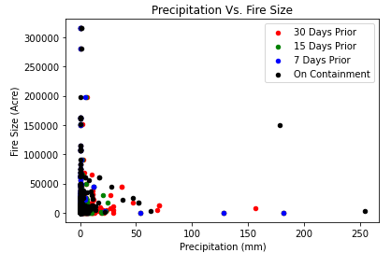
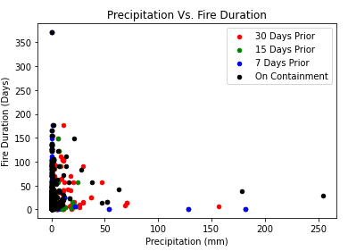
Precipitation
Data for both graphs is clumped at 0 precipitation
Fires greater than 75,000 acres have little to no precipitation

Slide 14
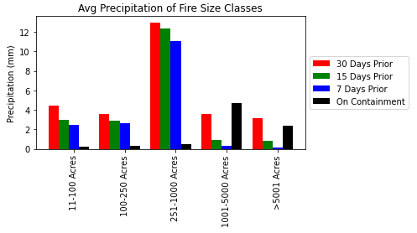
Precipitation
Precipitation averages are surprisingly high 30 days prior
Large fires have spike of precipitation on containment. Rainfall may have helped containment
Fires between 251 and 100 acres have much higher precipitation levels than other size groups
Could be related to storm systems with lighting causing mid-range fires
Precipitation for fires 11-250 acres is suspiciously low. Could be data error.

Slide 15
effect of Wildfires: Air Quality
Is there a difference in PM_{2.5} (air pollutant) concentration
before and after the Woosley fire?

Slide 16

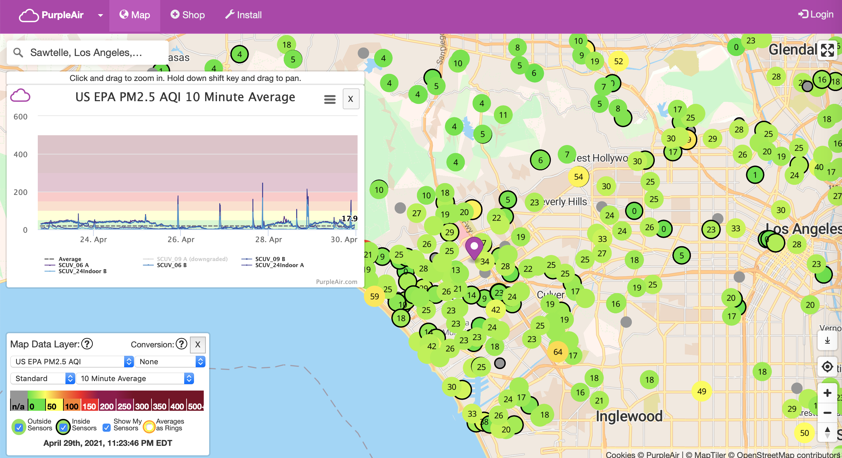
Low-cost air sensor

Slide 17
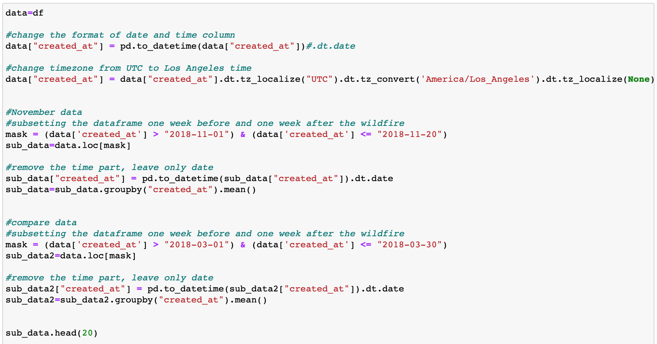
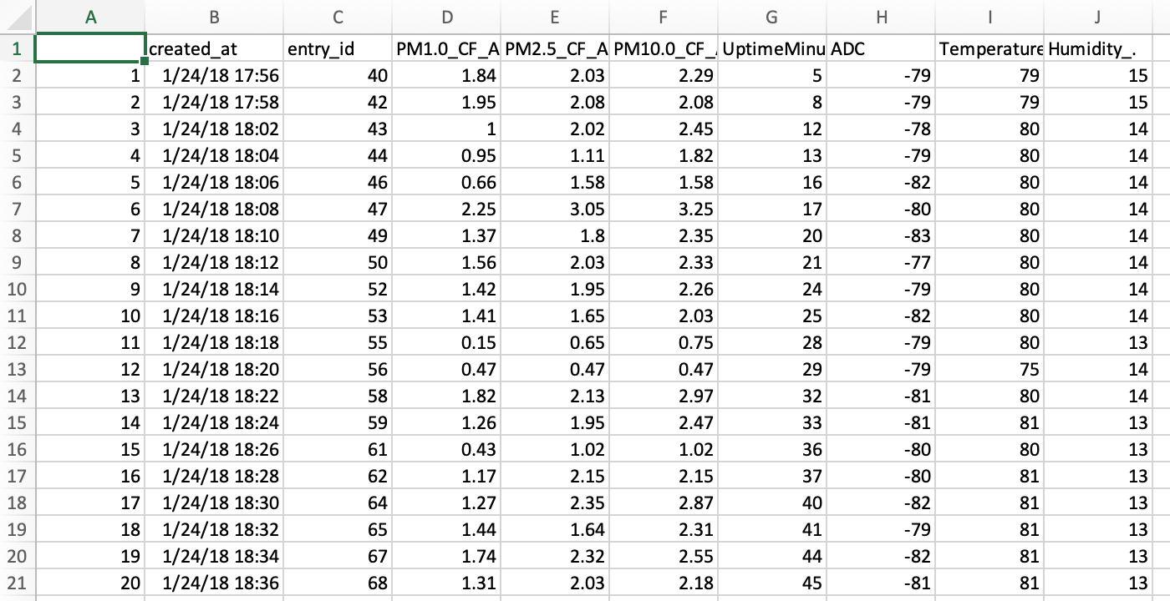
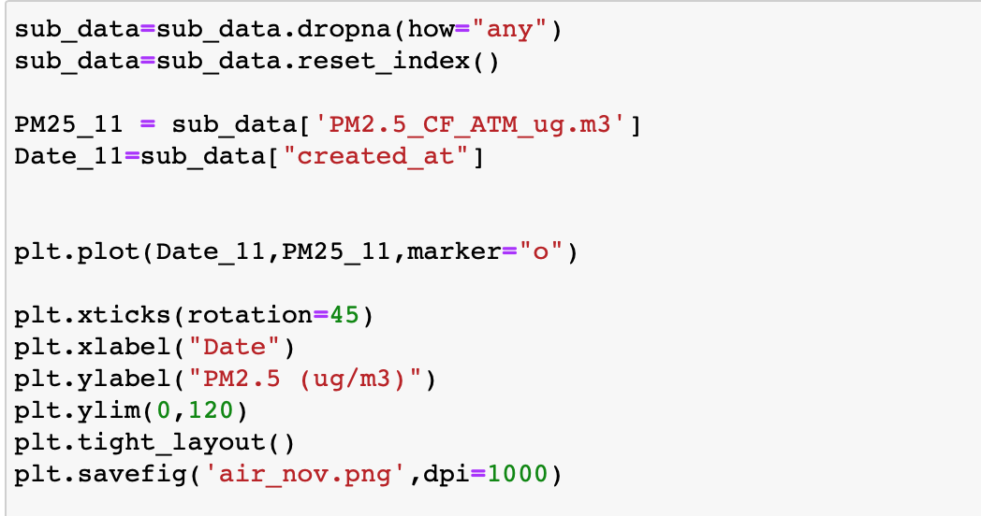
Data Cleaning and Processing

Slide 18
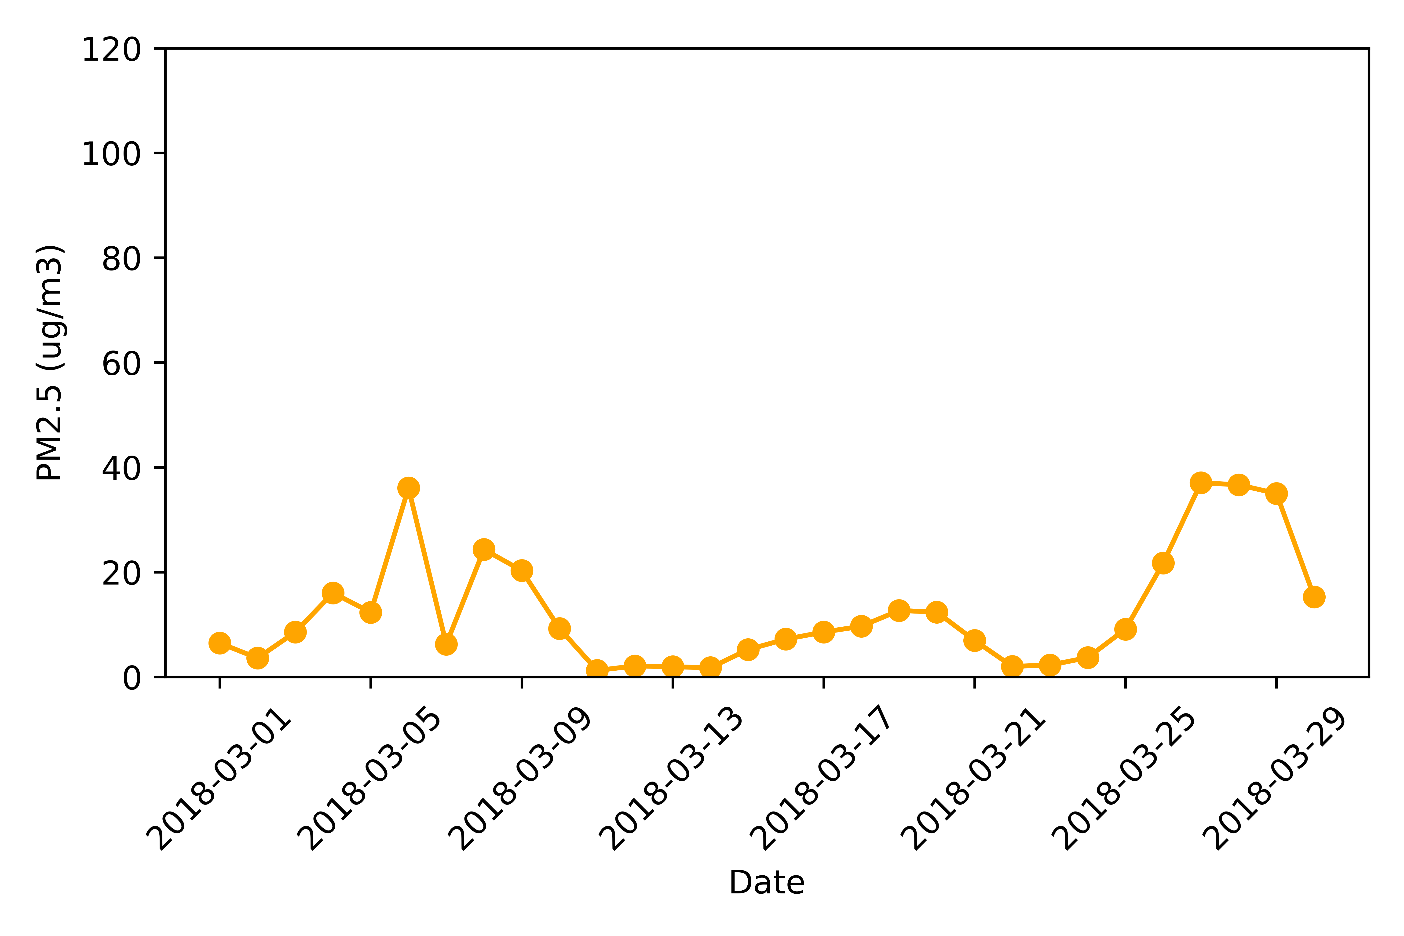
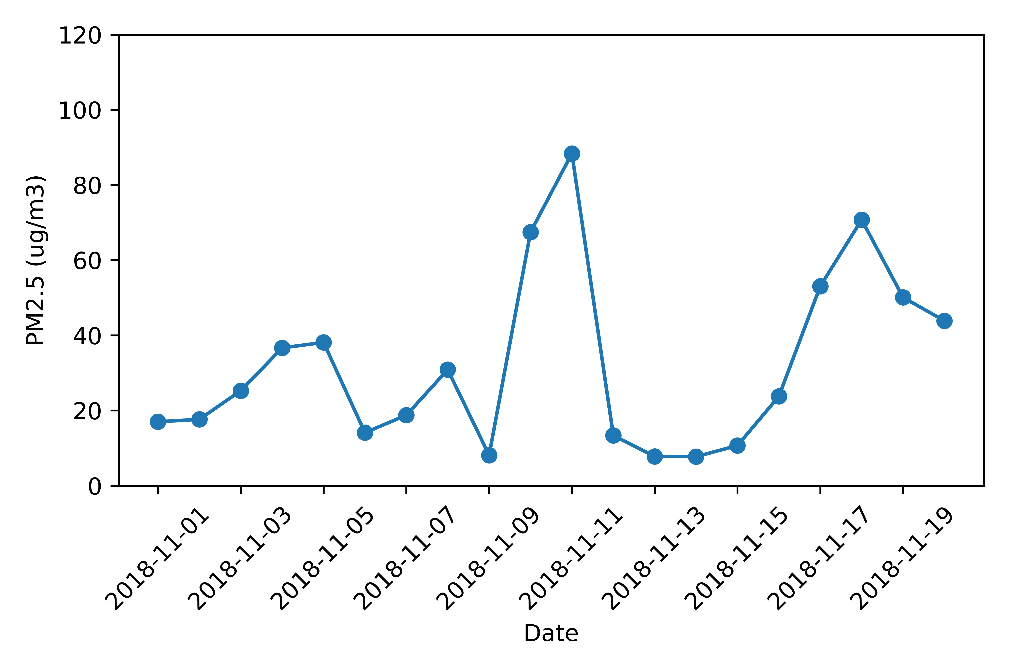
Non-wildfire season
wildfire season
Woosley Fire starts
EPA 24 hours standard: 35ug/m³

Slide 19



